Slide 1
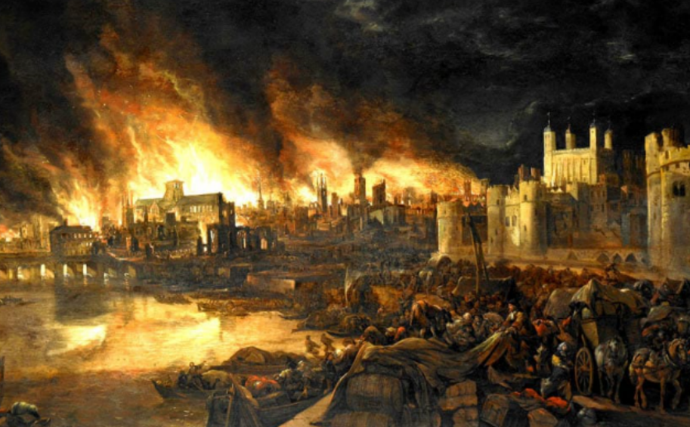
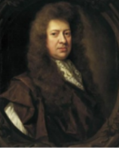
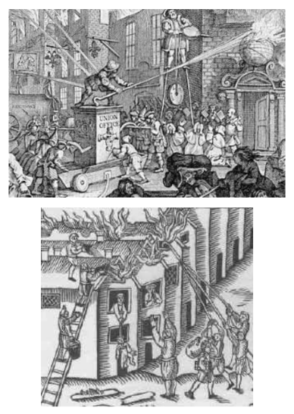
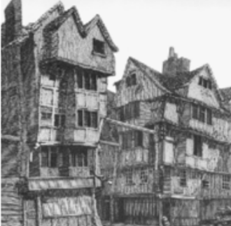
The Great Fire of London started on Sunday, 2 September 1666 in a baker's shop on Pudding Lane belonging to Thomas Farrine). The fire moved quickly down Pudding Lane and carried on towards the River Thames. It spread quickly because of strong winds and the fact the houses were made out of wood. It took 5 days to put the fire out and thousands of peoples homes were destroyed.

