Slide 1
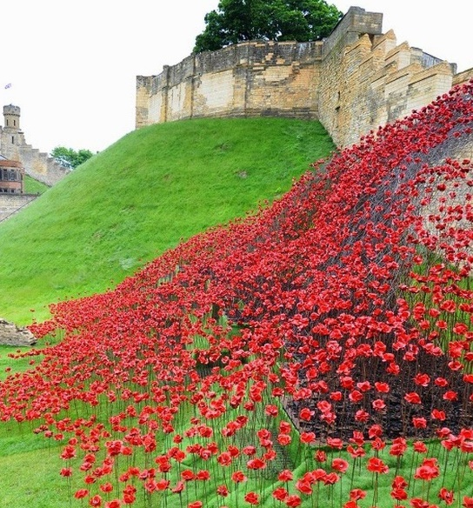
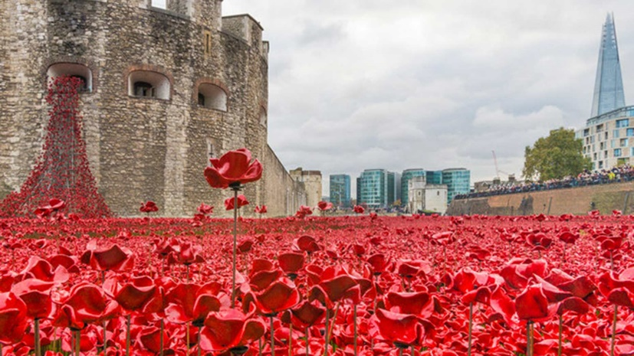
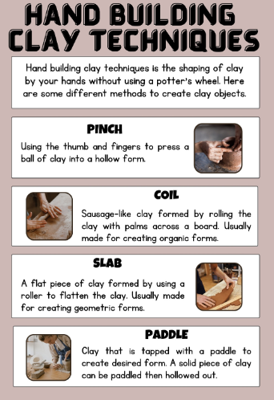
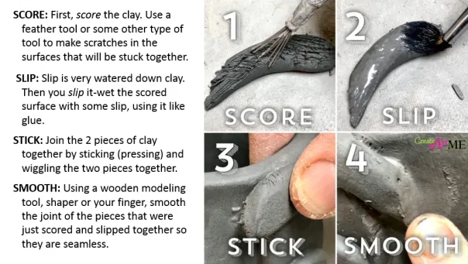
Year 6 Clay Poppies Knowledge Organiser
The installation at the Tower of London included 888,246 ceramic poppies, representing each death in the British and Colonial forces between 1914 and 1918
It was created by Derbyshire artist Paul Cummins and designed by Tom Piper. It was named Blood Swept Lands and Seas of Red after a line written by a soldier who died in Belgium
Wave and the Weeping Window, which together have more than 10,000 ceramic poppies, were bought for the nation last year by the charities Backstage Trust and the Clore Duffield Foundation
A total of £9m was raised for six military service charities after most of the poppies, which were handmade in Derby, were sold to members of the public for £25 each
An exhibition of ceramic poppies at Lincoln Castle marking the centenary of World War One attracted over 500,000 visitors.
Recall and Remember
Clay has 2 main properties: Plasticity - the ability to hold its form while at the same time be pliable enough to be moulded.
Porosity – coarse enough to allow water to escape evenly from all surfaces so that it doesn’t crack and holds its shape when fired.
Ceramics is the art of making heat and corrosion resistant objects out of different types of clay which has been moulded or shaped and then fired at a high temperature, to harden it. Ceramics can be both practical items and artistic sculptures. To make them waterproof ceramics are coated with glaze. Coloured glaze is often used to add decoration.
Key Vocabulary
Concept | An idea that leads to specific form of drawing, painting or sculpture.
Sculpture | The art of making three-dimensional representatives or abstract forms.
Ceramic | Pots and other articles made from clay, hardened by heat.
Fired | To heat clay and glazes up to a high temperature.
Enamelling | To coat or decorate a hard object with a semi-transparent glossy substance.
Interpret | Showing your own understanding of something.
Interpretation | Explain your own understanding of something.
Critique | Express an analysis of the merits and faults of work of art.

