Slide 1
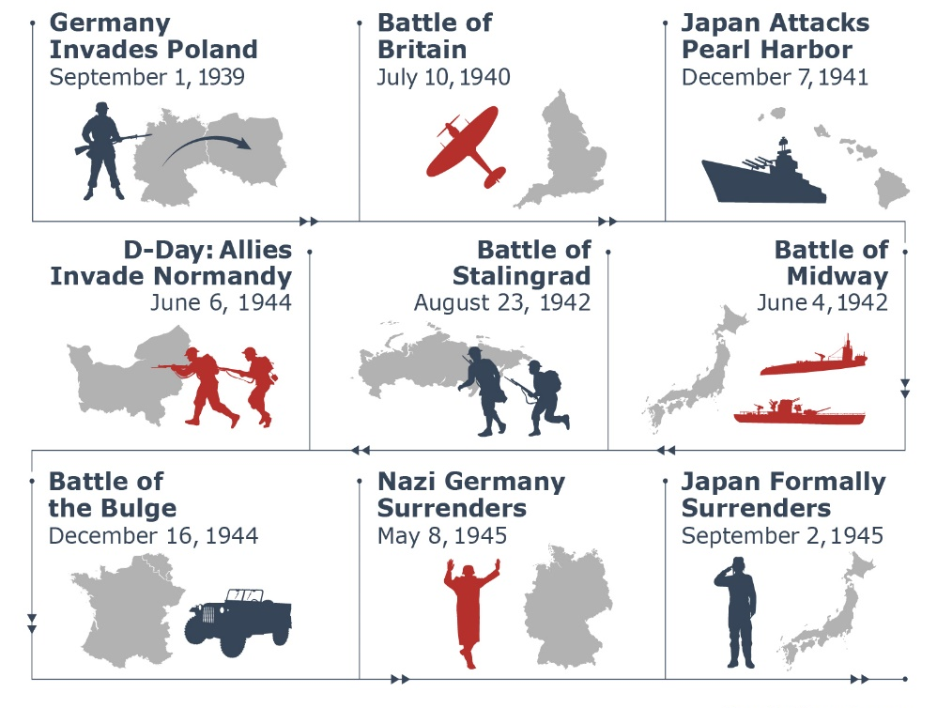
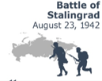
Bomber County: KS2 Knowledge Organiser
In September 1939, Britain entered into World War II, after Germany invaded Poland.
The major Allied Powers were Britain, France, Russia, China and the United States. The major Axis Powers were Germany, Italy and Japan.
Axis | Countries which fought on the German side.
Allies | Countries which fought on the British side.
Nazi | Member of the German political group which came to power in 1933.
Blitz | A series of bombing raids on the UK.
Dambusters | A bombing raid to destroy three dams in the Ruhr valley.
Bomber County | The Lincolnshire County because of the number of Bomber Command Squadrons based there during WWII
Propaganda | Controlling news media (such as radio) to depict the war effort .
Holocaust | Murder of Jews and other groups of people by the Nazis.
Key Turning Points
The Dambusters Raid
May 16th 1943

