Slide 1
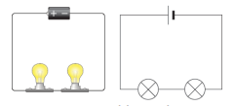
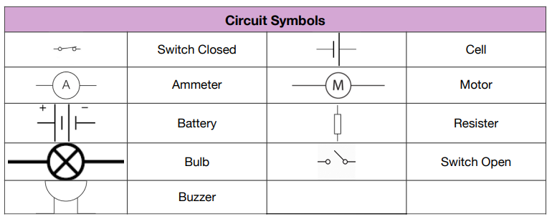
Year 6 – Electricity Knowledge Organiser
Series Circuit
.
Vocabulary
Circuit | A complete route which an electric current can flow around.
Component | The parts of which something is made.
Conductor | A substance that heat or electricity can pass through or along.
Electricity | A form of energy that can be carried by wires and is used for heating and lighting, and to provide power for devices.
Insulator | A non-conductor of electricity or heat.
Resistance | A force which slows down a moving object or vehicle.
Voltage | The force of an electric current as measured in volts.
Series Circuit | A series circuit is a closed circuit in which the current follows one path.
Parallel Circuit | Closed circuit in which the current divides in two or more paths before re-joining.
Parallel Circuit

