Slide 1
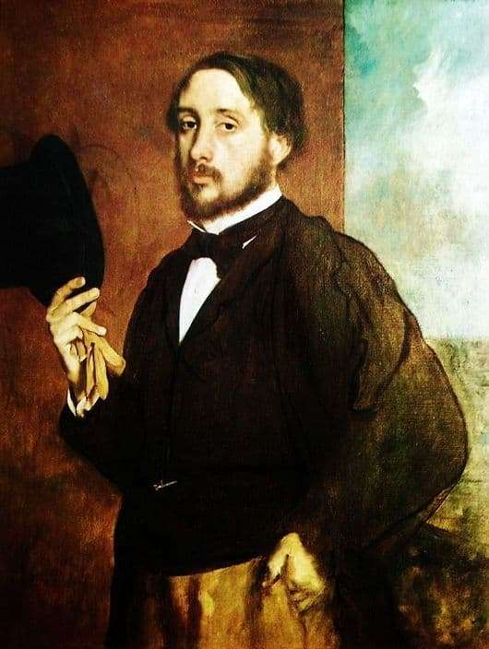
Year 6 Art – Figure Drawing Knowledge Organiser
Key Vocabulary
Combination | Merging different parts or qualities. Degas used a combination of different media to create his drawings.
Composition | The way in which parts are put together to create an outcome.
Hatching | Placing lines at an angle to one another to create tone and shading.
Impressionism | Art style which focuses on creating the impression of the moment.
Observations | In art, engaging with surroundings – thinking about what you can see and how it makes you feel.
Proportion | Relationship between height, width and depth.
Scale | Relationship between the size of one object to another.
Tonal | A range of how dark or light a colour is.
Edgar Degas
French Impressionist
1834 - 1917
Combined different media to create texture and line in order to reflect light and movement.
Known as an Impressionist although he thought of himself as a Realist.
Preferred to depict indoor scenes instead of outdoor scenes, like other Impressionists.
Focused on recreating movement, particularly the movement of ballerinas.
Edgar Degas
Key Knowledge

