Slide 1
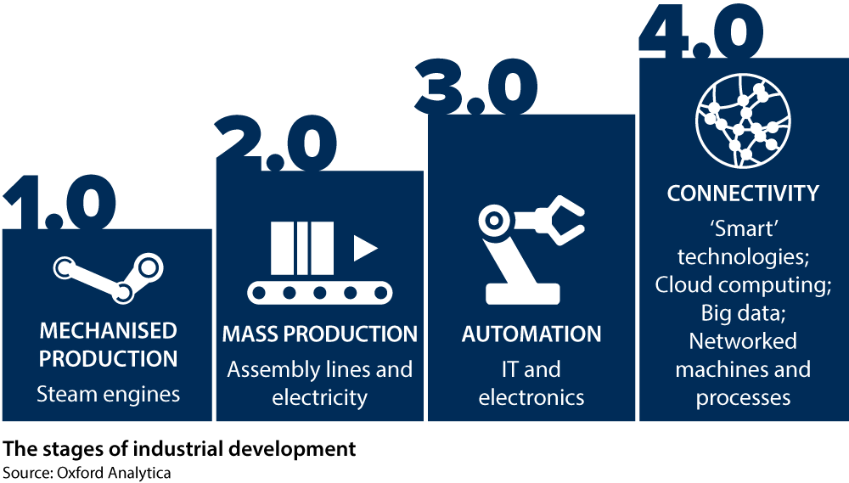
Year 6 History – The Industrial Revolution
What made the Industrial Revolution a significant turning point in British history and what impact did it have on people’s lives?
Key Vocabulary
Agriculture | The practice of growing crops and raising animals/livestock.
Economy | The process and systems where goods and services are produced, sold and bought.
Factory Act | Rules which should be legally followed to regulate and improve working conditions.
Industrial Revolution | The process of change from an agricultural industry and economy to a machine dominated industry and economy.
Industry | A group of manufacturers and businesses that sell similar products and services.
Manufactoring | The making of products on a large scale using machines.
Mechanised | Uses machines or automatic devices within a process
4 Waves of
Industrial Revolution
First Wave of the Industrial Revolution
1760 - 1840

